Slide 1
SAML2.0
Creating Service Provider Application
ASP.NET Web Forms
Using ComponentSpace.dll

Slide 2
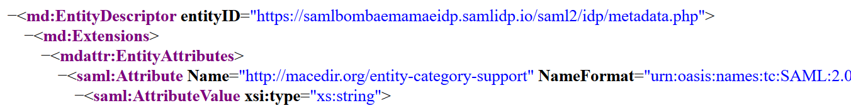
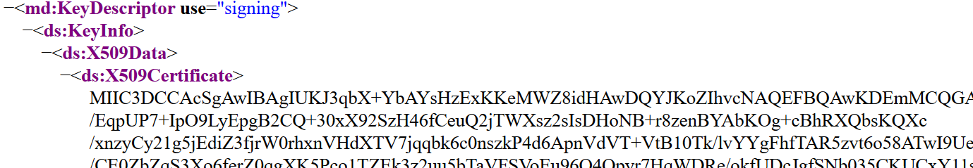
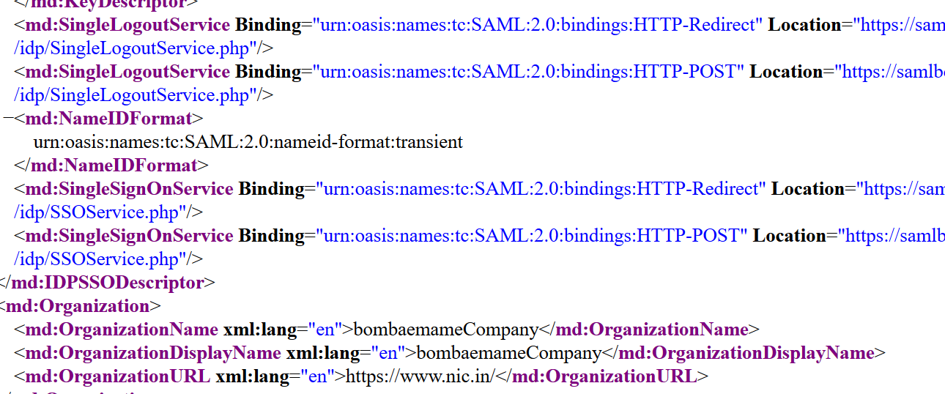
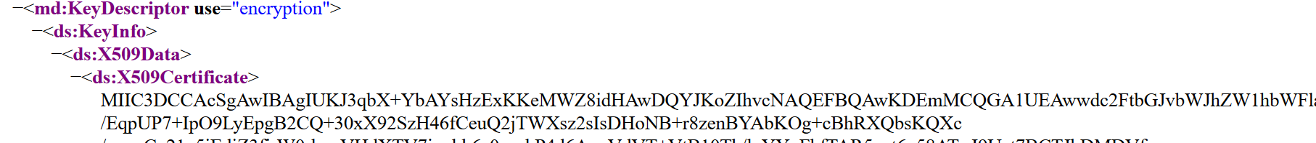
Trial Identity providers https://samlidp.io/idp/

Slide 3
This key is to be copied to my idp.cer, and this is the public key of My IDP.
How about this. . Does IDP use the same key for encryption??
Your reply : The IdP encryption certificate is not used and can be ignored.

Slide 4
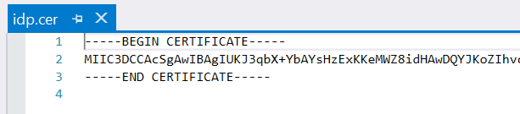
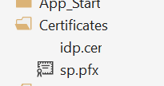
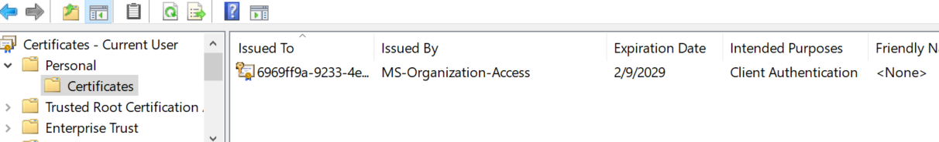
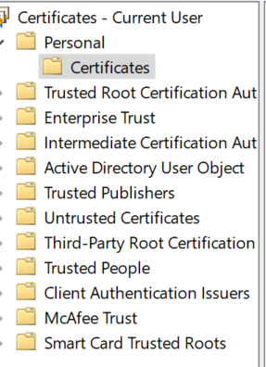
Copied the key to my idp.cer
I do not know where from I can get this key.
I am creating a service provider app, so this key is my local machine private key
or something else.
Please guide me on this..
Your reply : The SP certificate is only required of you're signing SAML messages. For example, if you specify SignAuthnRequest="true" in your saml.config, the local certificate is used to perform the signing. Please take a look at the Certificate Guide in the documentation folder for more information.

Slide 5
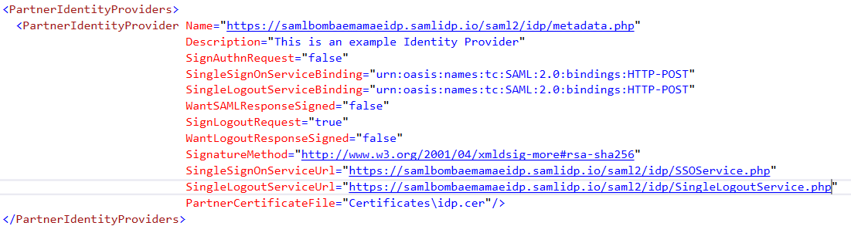

Slide 6
I have learned about HTTP-POST, Artifact, Redirect bindings..
On using HTTP-POST what features I wont get…??
Answer : There are no differences in features whether you use HTTP-POST or HTTP-Redirect. HTTP-Artifact isn’t commonly used as it requires a backend SOAP channel.
Can I use HTTP-POST with SignAuthRequest = true , wantSAMLResponseSIgned = true, wantLogoutResponseSigned = true?
If not why?
Answer: Yes.
And if I use Redirect bindings what changes are to be made ?
Answer : By default SAML authn requests are sent using the HTTP-Redirect binding so no changes are required. HTTP-Redirect is the recommended binding to use in this case. SAML response messages are received from the IdP using HTTP-POST.

Slide 7
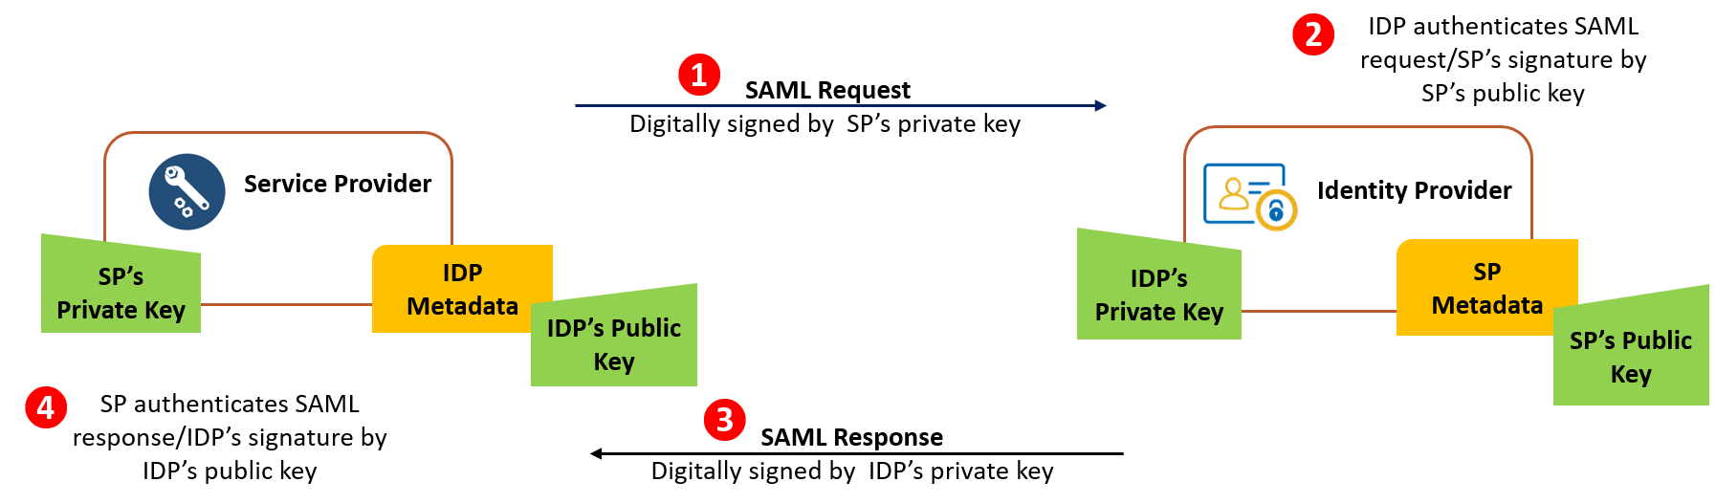
So, I am using the public key of my IDP to authenticate SAML response….
So I need to even provide service Provider public key to IDP for authenticating SAML request…so where I can find both private and public key..?
Answer: If you’re signing SAML authn requests you do so with your own private key. Often a self-signed certificate/private key are created for this purpose. Please refer to the Certificate Guide for information on creating self-signed certificates.

Slide 8
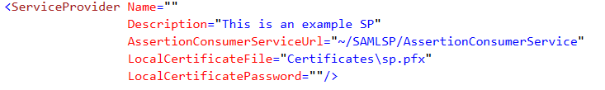
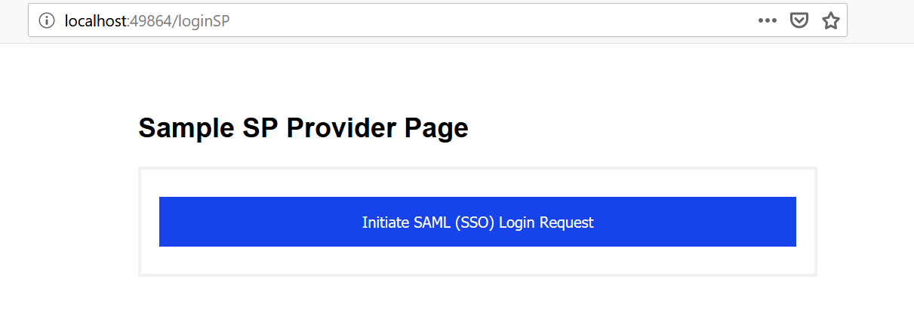
What name I should provide here…is it application name i.e
http://localhost:49864/loginSP
Answer : We recommend a URL that is your web application’s home page. However, any URL that uniquely identifies your SP is fine.
Please assist me on local certificate or sp.pfx
Answer: Please take a look at our Certificate Guide. There are a number of options listed but many organizations create their own self-signed certificate/private key. You can do this using PowerShell as documented in the Certificate Guide.

Slide 9
IDP
My Service Provider app
As of now I am using my Service provider app to authenticate users.
How to access my Service Provider app from my other web applications….
Answer : Other applications can also participate in SAML SSO with the IdP. Alternatively, you could use SAML SSO with the IdP from your SP application and use a non-SAML SSO method to share identity internally between your applications (eg using OIDC).
IDP
Abc web app
My Service Provider app

